Slide 1
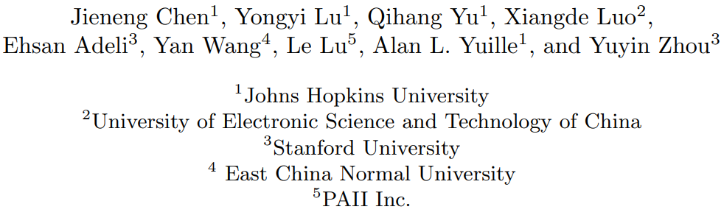
TransUNet: Transformers Make Strong Encoders for Medical Image Segmentation 2021 arXiv
Keyword:
Transformer、Self-Attention
指導老師: 連震杰 教授
學 生: 鄭琮寶
2023/06/07

Slide 2
Content
0. Roadmap
Introduction
1.1 Motivation, Objective and Global Framework
1.2 Related Works
1.3 Contribution
System Setup and Functions
2.1 System Setup
2.2 Function Specifications
3. Frameworks
3.1 Training Process and Inference Process
3.2 Methodology
4. Experimental Results
4.1 Data Collection and Metric
4.2 Experimental Results
4.3 Ablation
4.4 Discussion
5. Conclusion
R. Reference
A. Appendix
Q. Q&A

Slide 3
0. Roadmap: From 2022/10/B to 2022/12/E
-Note:
Black: Done
Red: On-going
Light Blue: Future work
2022
10
11
12
1. Paper Study
2. Experiment
2.1. Lung Nodule Detection
2.1) 10/B ~ 10/M: Coding:
3D U-Net: Learning Dense Volumetric Segmentation from Sparse arXiv2016
1.1) History: re-train by missing data, 1.2
2.1) 測試更多Ln & Me data, 2.0
2.2) FP of 3D nodule number.
3.1) Loss: Lobe segmentation
3.2) Loss: +Vessel
3.3) Loss: 彥博， gradient loss ??, Distance Transform
3.4) Loss: Input label image like openpose body centroid or Tony labeling
4.1) 3D Patch-based
2.1) 10/M ~ 12/M: Coding:
Attention Gate ResU-Net for Automatic MRI Brain Tumor Segmentation
2.2. TSMC Interview
2.2) 11/M ~ 12/M: Interview:
TSMC Interview

Slide 4
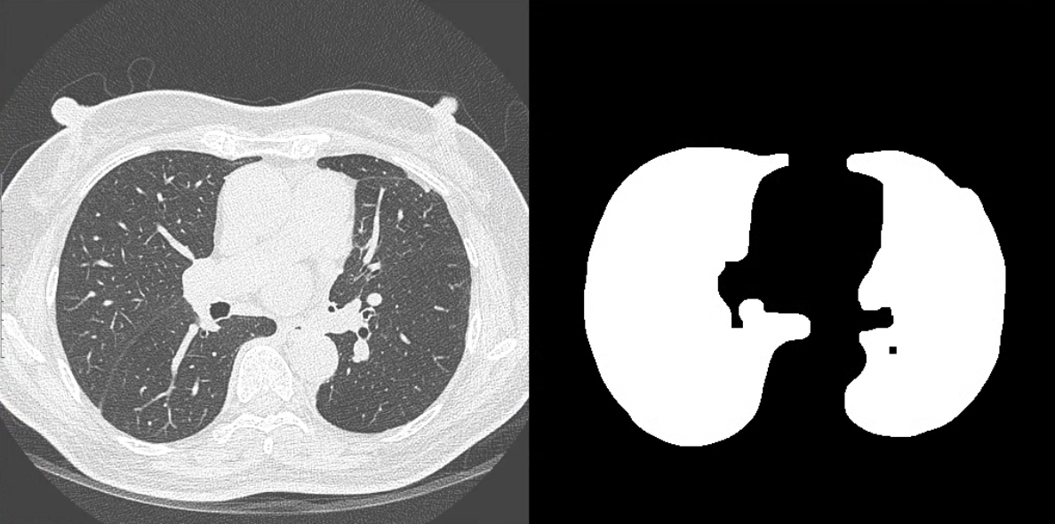
0. Roadmap: From 2023/01/B to 2023/03/E
-Note:
Black: Done
Red: On-going
Light Blue: Future work
2023
01
02
03
20230322
Slice merge average or max
Lobe Segm before or after network
Train missing data
Find paper segm (nodule) (conv + transformer + loss function) ??
1) Anylaze 4mm以上 (missing nodule)
1. Paper Study
2. Experiment
2.1. Lung Nodule Detection
2.1) 01/B ~ 01/E: Coding:
Attention Gate ResU-Net for Automatic MRI Brain Tumor Segmentation
2.2. Support Doctor
2.1.0: 3D Attention Unet
2.1.1: 3D Attention Unet + ASPP: More Testing
2.1.2: Loss: Distance Transform: Training
Loss: Distance Transform: Testing
2.1.3: Loss: unified focal loss: Training
Loss: unified focal loss : Testing
2.1.4: Input 3D Patch-based: Training
Input 3D Patch-based: Testing
2.2) 01/B ~ 01/M: Data pre-processing:
Classify far & close, Data Augmentation
Lung Team Roadmap:
02/E ~ 02/E: Benchmark + data for 3 hospitals
03/B ~ 03/M: 1AG+3CO FL模擬運作
03/M ~ 04/M: 1AG+3CO(PC)系統認證完成
04/M~ : Deploy to 3 hospitals
1.1) History: re-train by missing data, 1.2
2.1) 測試更多Ln & Me data, 2.0
2.2) FP of 3D nodule number.
3.1) Loss: Lobe segmentation
3.2) Loss: +Vessel
3.3) Loss: 彥博，gradient loss ??, Distance Transform
3.4) Loss: Input label image like openpose body centroid or Tony labeling
4.1) 3D Patch-based
20230301
1) 3D Attention Unet (model Edit => shortcut ??)
2) 1) + Data Post-processing (check)
3) 換Loss (focal loss ?? softmax (two channel) Fore, back => dice ?? xx)
分兩類 => similar focal loss
4) Train missing data

Slide 5
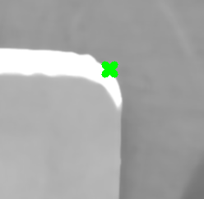
0. Roadmap: From 2023/04/B to 2023/06/E
-Note:
Black: Done
Red: On-going
Light Blue: Future work
2023
04
05
06
1. Paper Study
1.1. Papers Related to Unet Segm
2.1) 05/B ~ 05/M: Paper9: Dl_Bme_Segm_TransUNet_ViT_arXiv2021
2.1.0 整理Segm相關的Related Work (Ex. Dl_Bme_Segm_Swin-Unet_Unet
like_Pure_Transformer_for_Medical_Image_ECCV2021)
2. Experiment
2.1. Lung Nodule Detection
2.1. Lung Nodule Detection
2.1) 04/B ~ 04/E: Coding (3D UNet):
Proj_Dl_Bme_Segm_UNet3d_Attent_LgNd_FpRd
2.1) 06/B ~ 06/E: Coding (3D Unet + Transformer):
Proj_Dl_Bme_Segm_UNet3d_Attent_LgNd_FpRd
2.1.0: FROC Curve、Data Augmentation => Precision上升
2.1.1: Training Missing & FP Table
2.1.2: Appendix PPT
2.1.0: 預計要做的Transformer Network
2.1.1: 比較加入Transformer前後的結果
2.1.2: 口試PPT (Ch3、Ch4、Ch5重點)
2.2. Support Doctor
2.2) 04/B ~ 04/M: Data pre-processing:
Classify far & close, Data Augmentation
Contribution
Panel Alignment System with UVW Platform (寫論文，但不報)
Find extreme corner point using computer vision technology (OpenCV)
Implement C++ program on “Nvidia Jetson Xavier” and “Tiger Lake i3”
Optimal program running time using MultiThread
Lung Nodule Segmentation using 3d attention Unet (寫論文+報告)
Add attention gate module and residual mechanism to 3d UNet
Segment 3d nodule sphere from LDCT image
Get more truth positive nodule (recall) from LDCT image using 3d attention UNet

Slide 6
-Paper:
Paper1: A. Geiger, M. Roser, and R. Urtasun, “Efficient Large-Scale Stereo Matching,” ACCV, pp. 25-38, 2010.
Paper2: Y. Hu, Y. Chen, X. Li, and J. Feng, “Dynamic Feature Fusion for Semantic Edge Detection”, arXiv preprint arXiv:1902.09104, 2019.
Paper3: X. Poma, E. Riba, and A. Sappa, “Dense Extreme Inception Network: Towards a Robust CNN Model for Edge Detection,” arXiv:1909.01955, 2020.
Paper4: N. Liu, N. Zhang, K. Wan, L. Shao, and J. Han “Visual Saliency Transformer”, arXiv:2104.12099v2, 2021
Paper5: L. Ke, X. Li, YW. Tai, CK. Tang, and F. Yu, “Mask Transfiner for High-Quality Instance Segmentation”, arXiv: 2111-13673, 2021
Paper6: J. Kone, HM. McMahan, D. Ramage and P. Richt “Federated Optimization: Distributed Machine Learning for On-Device Intelligence”, arXiv:1610.02527, 2016
Paper7: A. Saha, M. Hosseinzadeh, and H. Huisman, “End-to-end prostate cancer detection in bpMRI via 3D CNNs”, MIA: 102155, 2021
Paper8: J. Mei, MM. Cheng, G. Xu, LR. Wan and H. Zhang “SANet: A Slice-Aware Network for Pulmonary Nodule Detection”, IEEE, 2021
Paper9: J. Chen, Y. Lu, Q. Yu, X. Luo, E. Adeli, Y. Wang, L. Lu, AL. Yuille and Y.Zhou “TransUNet: Transformers Make Strong Encoders for Medical Image Segmentation”, arXiv:2102.04306, 2021

Slide 7
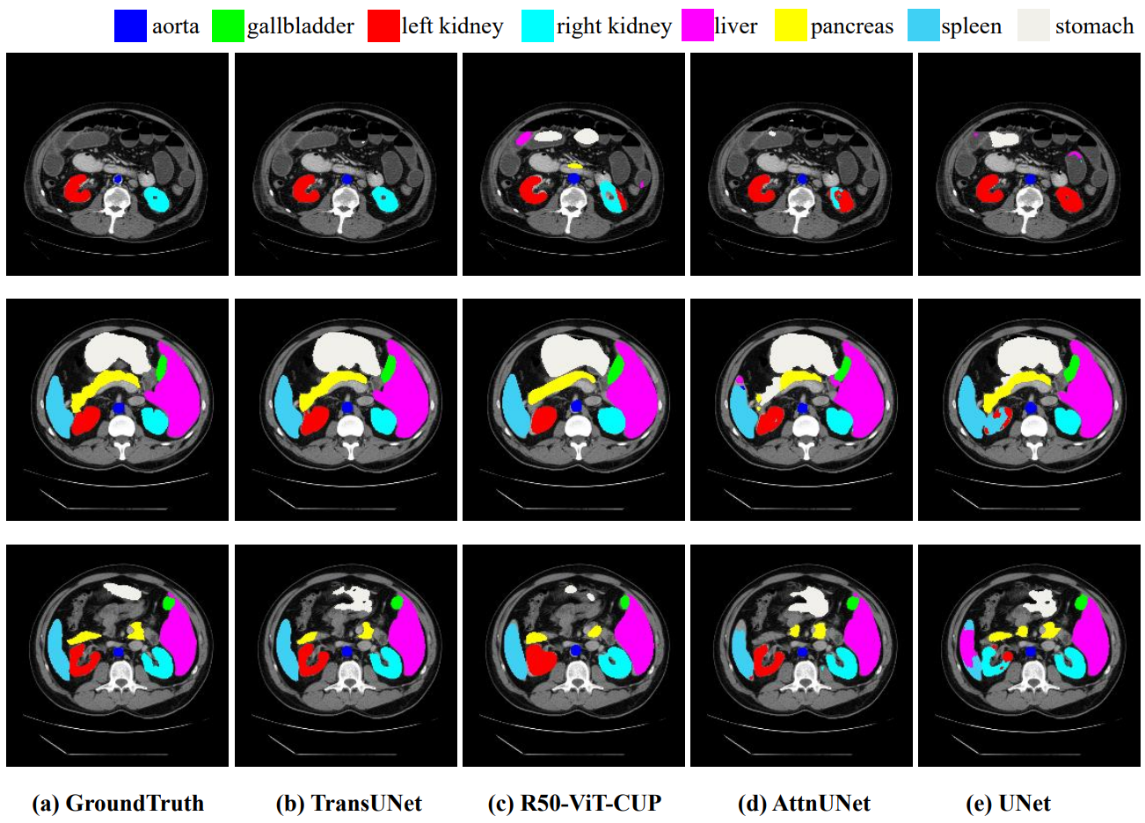
1.1 Motivation and Objective
1. Motivation: Medical image segmentation is an essential prerequisite for developing healthcare systems, especially for disease diagnosis and treatment planning.
Convolutional neural network
CNN-based approaches generally exhibit limitations for modeling explicit long-range relation, due to the intrinsic locality of convolution operations.
CNN-based architectures generally weak performances especially for target structures that show large inter-patient variation in terms of texture, shape and size
This work: Transformer UNet (TransUNet)
Establishes self-attention mechanisms from the perspective of sequence-to-sequence prediction to get more global information.
TransUNet employs a hybrid CNN-Transformer architecture to leverage both detailed high-resolution spatial information from CNN features and the global context encoded by Transformers.
2. Objective:
1) Get more information by Self-Attention
2) Combining CNNs with self-attention mechanisms
7
Notes:
(主動脈、膽囊、左腎、右腎、肝臟、胰腺、脾臟、胃)

Slide 8

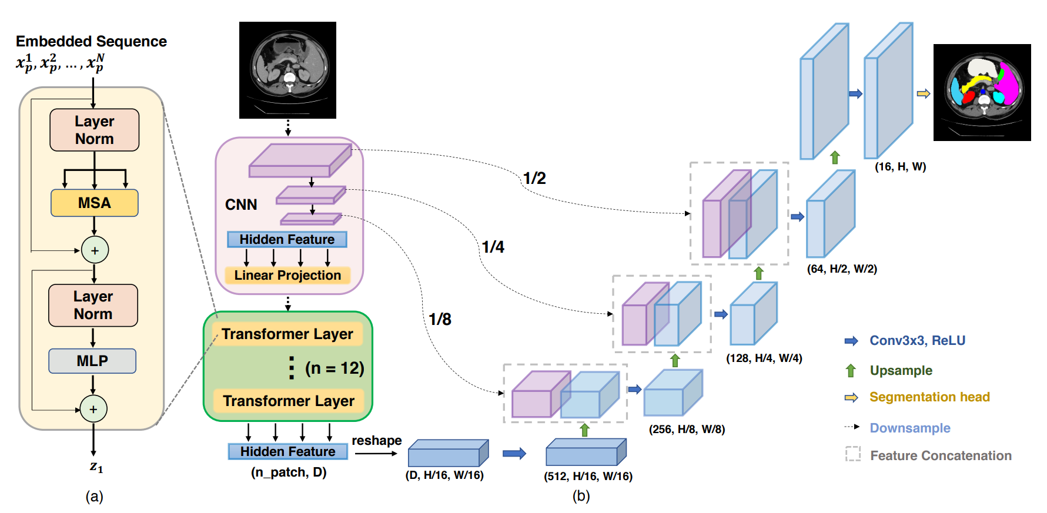



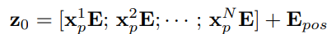
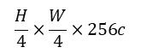
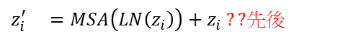
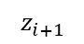
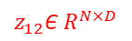
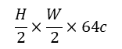
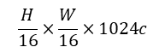
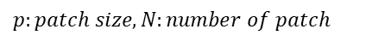
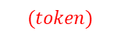
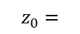
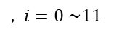
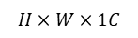

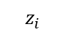
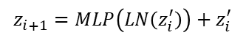
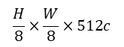
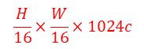
1.1 Global Framework
Author: CNN-Transformer better than pure transformer
1. DownSampling
3. UpSampling ??
$$H×W×1C$$
Hybrid Model ??
1. ResNet50改良(Reference: ViT[4])
2. BatchNorm改成GroupNorm
3. 傳統的Conv2d改成StdConv2d ?? (以什麼為單位做標準化??)
$$\frac{H}{2}×\frac{W}{2}×64c$$
Why Hybrid Model ??
主要因為BN受batch size大小的影響大(需大量Resource)，BN中權重的更新對於Transfer Learning不友好
Reference: (1912.11370.pdf (arxiv.org))
$$\frac{H}{4}×\frac{W}{4}×256c$$
$$\frac{H}{8}×\frac{W}{8}×512c$$
(8, H, W)
8 classes
$$\frac{H}{16}×\frac{W}{16}×1024c$$
$$\frac{H}{16}×\frac{W}{16}×1024c$$
(3x3x16c)x8 filter
2. Transformer
1) Patch vector (no overlapping)
3) Multi Head Self-Attention (x12)
${x_{p}=\{x}_{p}^{i}$ Є $R^{1×(p^{2}×1024c)} \left| i=1,…N\right\}, N=\frac{HW}{{16}^{2}p^{2}}, p=1$
$z_{i}^{′} =MSA\left(LN\left(z_{i}\right)\right)+z_{i} ??$先後
$$p:patch size, N:number of patch$$
$J$ack ??
$$z_{i+1}=MLP\left(LN\left(z_{i}^{′}\right)\right)+z_{i}^{′}$$
$, i=0 \sim 11$
$$z_{12}\text{Є} R^{N×D}$$
2) (Reshape) + patch embedding D-dim & position embedding
$$z_{0}=$$
$$z_{i}$$
$$z_{i+1}$$
$$(token)$$
$E$ Є $R^{\left(p^{2}×1024c\right)×D filter}, { E}_{pos}$Є $R^{1×D},z_{0}\text{Є} R^{N×D},x_{p}$ $E$ Є $R^{1×D}$
Notes:
Visual Transformer: https://arxiv.org/abs/2010.11929
https://zhuanlan.zhihu.com/p/464920124
https://hackmd.io/@YungHuiHsu/ByDHdxBS5

Slide 9
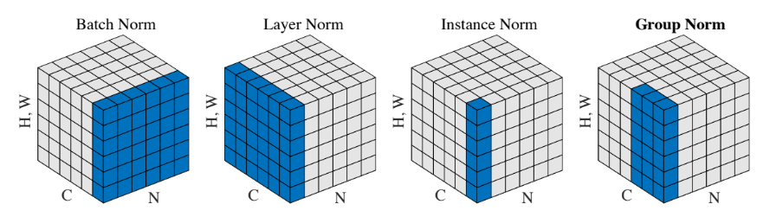
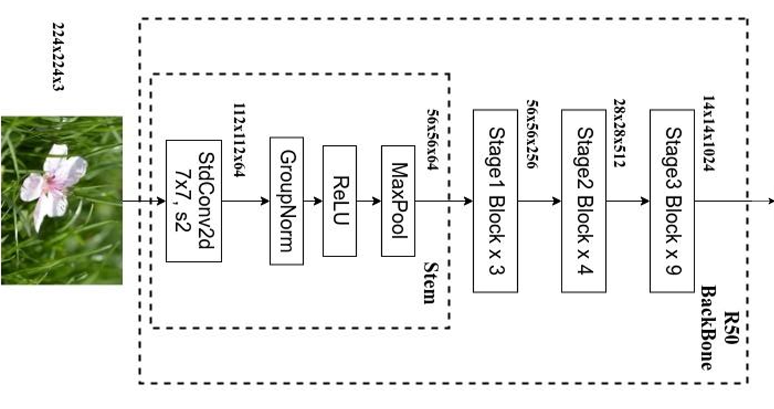
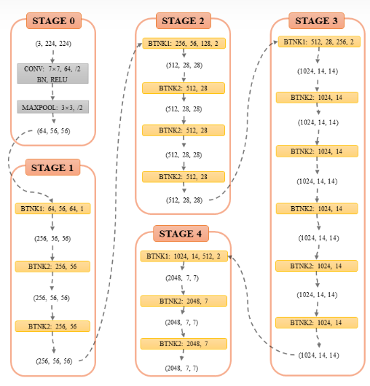
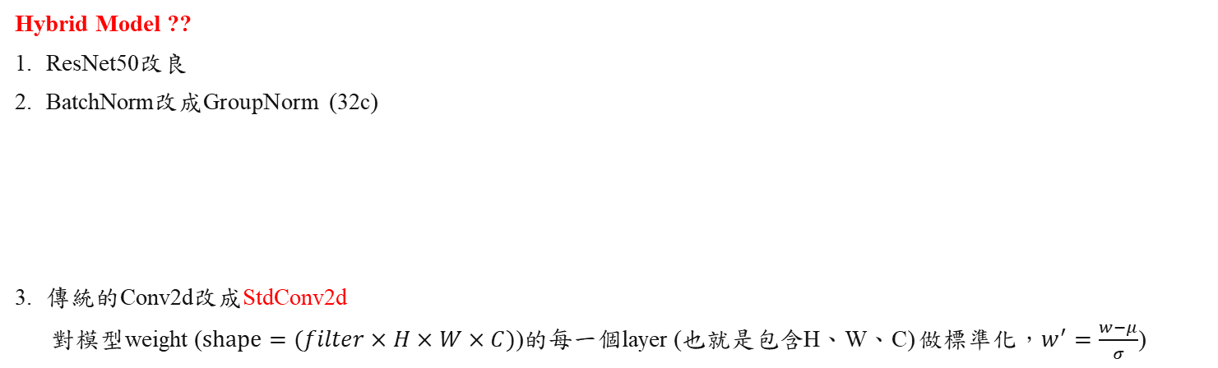
1.2.0 Related Work
ViT[4] An image is worth 16x16 words: Transformers for image recognition at scale.
Hybrid Model ??
ResNet50改良
BatchNorm改成GroupNorm (32c)
傳統的Conv2d改成StdConv2d
對模型weight ($shape=(filter×H×W×C)$)的每一個layer (也就是包含H、W、C) 做標準化，$w^{′}=\frac{w−μ}{σ}$)
Reference Paper (1912.11370.pdf (arxiv.org))
使用Group Normalization (GN)、Weight Standardization (WS) 替換Batch Normalization (BN) 。主要因為BN受batch size大小的影響較大(需要大量的Resource)，BN中權重的跟新對於Transfer Learning (Based on PreTrain ViT[4])不友好。實驗證明，GN、WS的設計對於遷移學習有很大的影響。
Hybrid Model
ResNet50

Slide 10
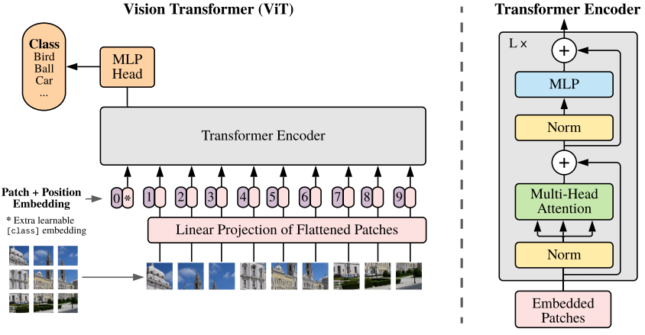
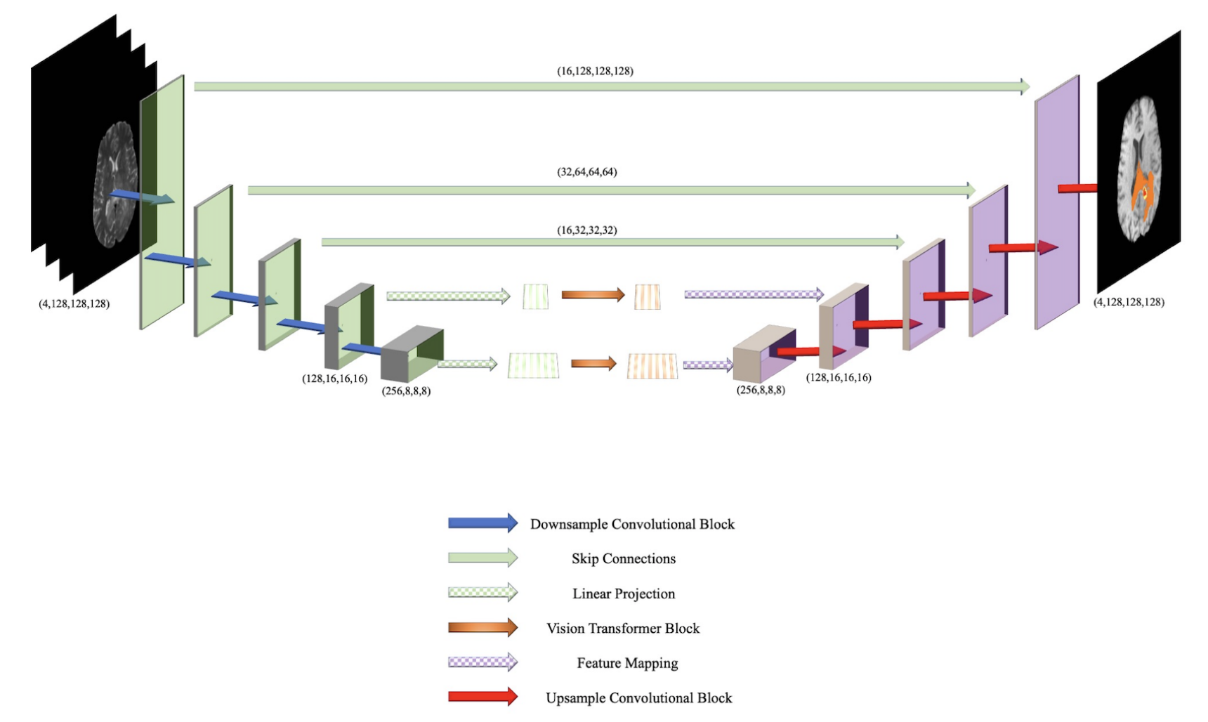
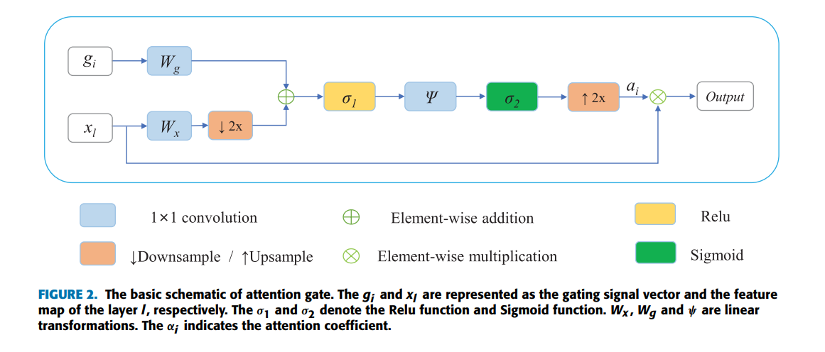
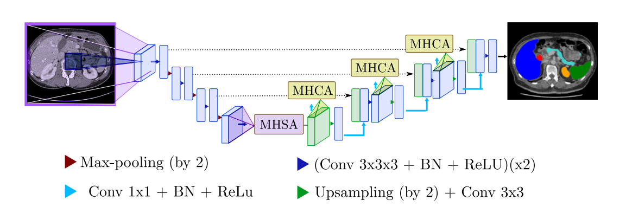
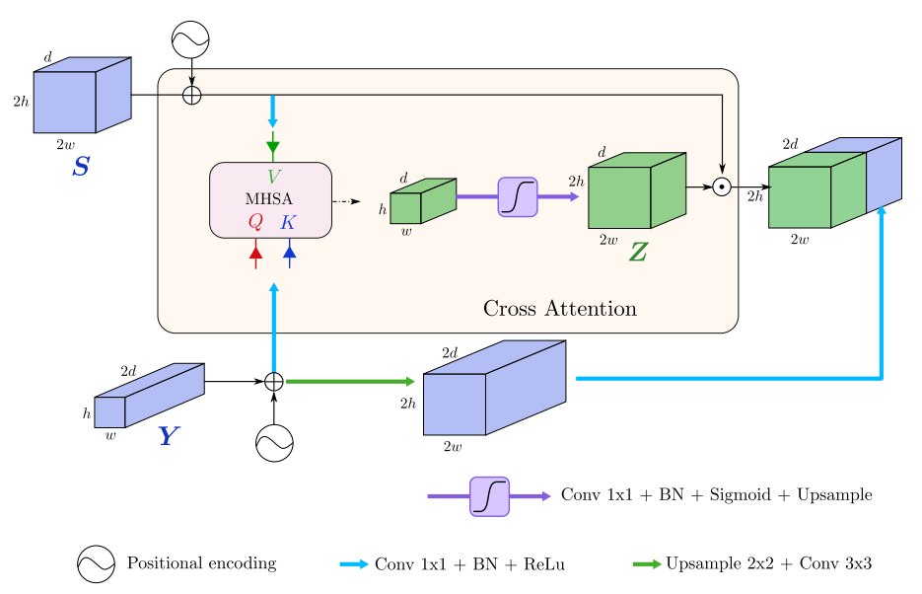
1.2.0 Related Work
transformer block
BiTr-Unet (Brain Tumor) find related paper & cite paper ??
Input four 3D MRI modalities images (128x128x128x4c)
Get more information on low resolution (global feature) feature using transformer block
Attention Gate (Pixel-wise)
U-Net Transformer
MHSA : multi head self attention (MSA)
MHCA : multi head cross attention (similar as “attention gate”)
Gate
Low resolution
X
High resolution
MHCA
X
High resolution
Gate
Low resolution
Reference:
BiTr-Unet: MICCAI2021, cite 32
U-Net Transformer: MLMI2021, cite 101

Slide 11
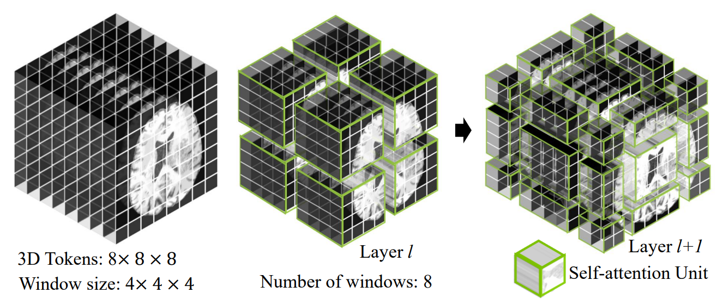
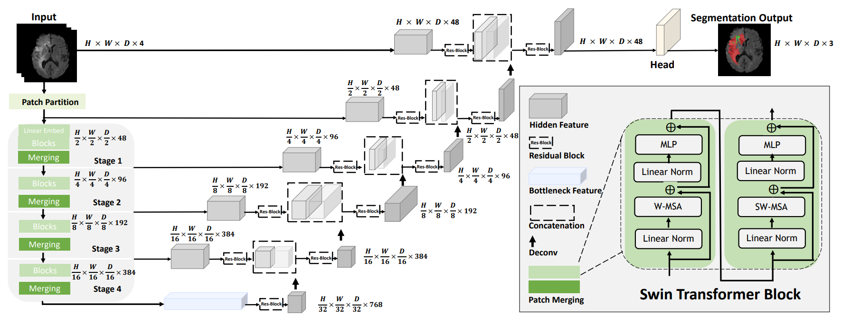
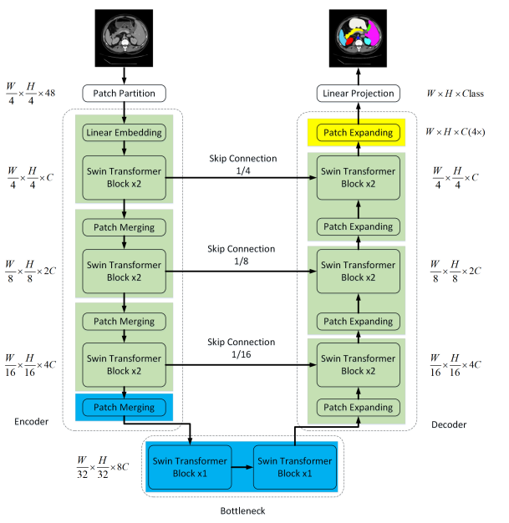
1.2 Related Work
Swin-UNETR
Input four 3D MRI modalities images (128x128x128x4c)
Feature extraction by Swin Transformer and downsampling by patch merging
Trained on a DGX-1 cluster with NVIDIA V100 GPUs x 8 (batch size = 8)
Swin-Unet ??
Input four 3D MRI modalities images (224x224x1c)
Feature extraction by Swin Transformer and downsampling by patch merging
Trained on a DGX-1 cluster with NVIDIA V100 GPUs x1
Patch Expanding (upsmapling)??
Patch expanding layer 以解码器中第一个为例，在上采样之前，在输入特征(W/32×H/32×8C)上應用線性層，将特征维度增加到2×原始尺寸(W/32×H/32×16C)。然后，利用rearrange操作，将输入特征的分辨率擴展到2倍的输入分辨率，并将特征维度降小到输入维度的四分之一(W/32×H/32×16C→W/16×H/16×4C)。（Patch merging的逆操作）
Reference:
Swin-UNETR: MICCAI2022, cite 123
Swin-Unet: ECCV2021, cite 676
Notes:
random axis mirror flip with a probability of 0.5 for all 3 axes

Slide 12
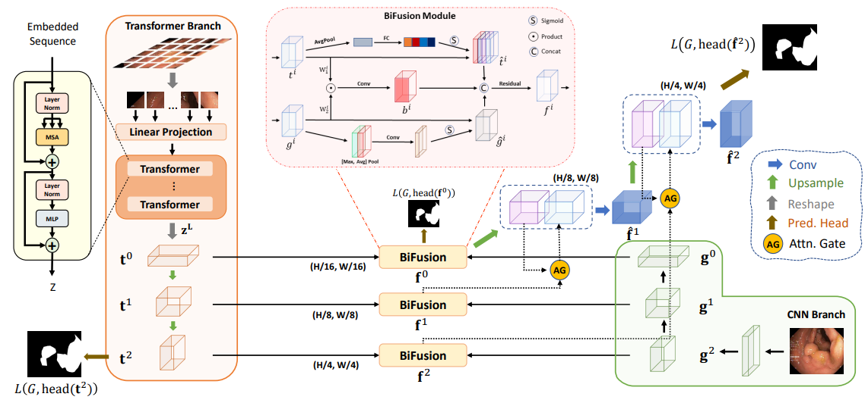
1.2 Related Work
TransFuse
Input four 3D MRI modalities images (128x128x128x4c)
Combine transformer and CNN feature using BiFusion module
Trained on NVIDIA A100 GPU x 1
Transf t
Channel Attention ??
Spatial Attention ??
CNN g
Reference:
Swin-UNETR: MICCAI2021, cite 340

Slide 13
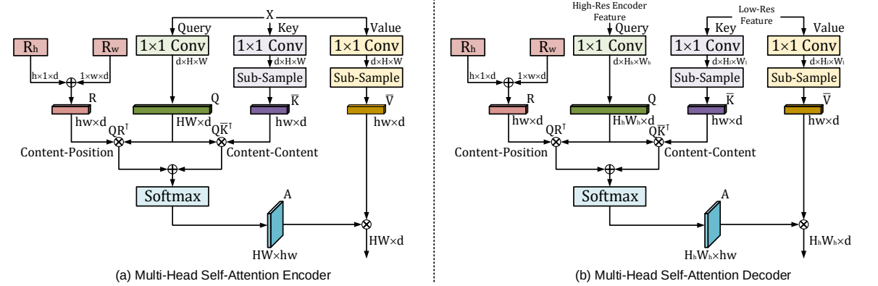
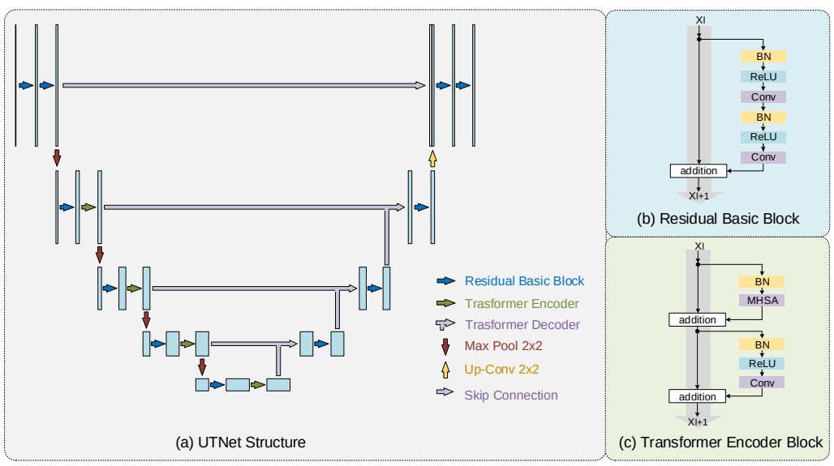
1.2 Related Work
UTNet
Input MRI 2D images (256x256x1c)
Combine transformer and CNN feature
Add transformer and CNN layer
Position embeding ??
Q(K+R) ??
Subpixel sample = upsample
Position embeding ??
Reference:
UTNet: MICCAI 2021, cite 174

Slide 14
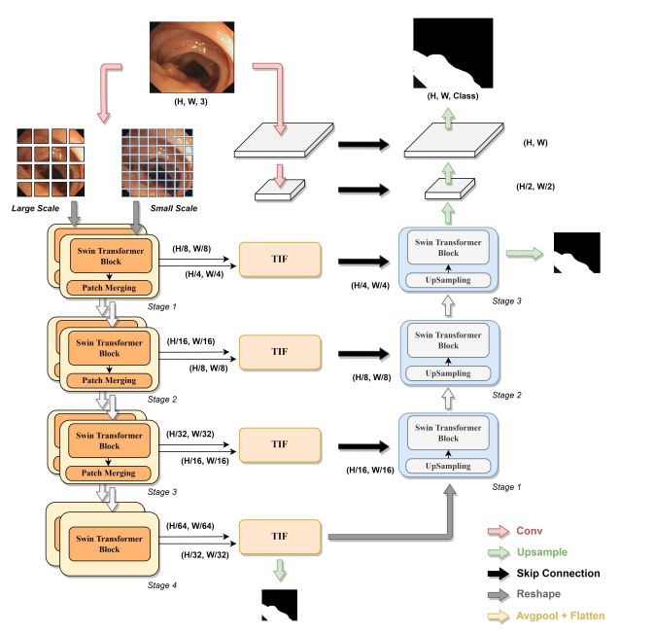
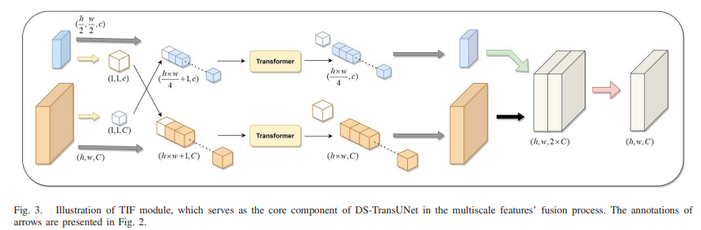
1.2 Related Work
DsTransUNet
Input 2D images (256x256x1c)
Dual Swin Transformer mechanism
Trained on NVIDIA RTX3090 GPU
The proposed TIF module is developed to establish global dependencies between features of different scales through the self-attention mechanism
GAP: Global Average Pooling
Upsampling
GAP
GAP
Reference:
DsTransUNet: TIM 2022, cite 130

Slide 15
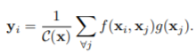
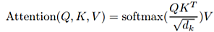
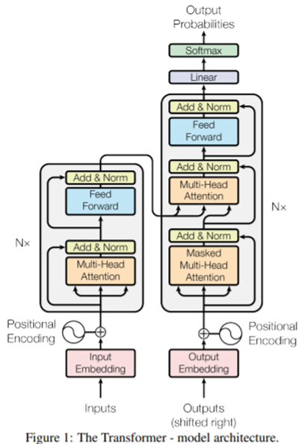
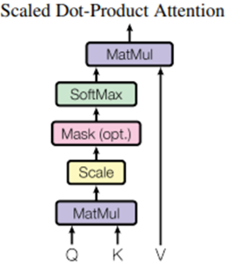
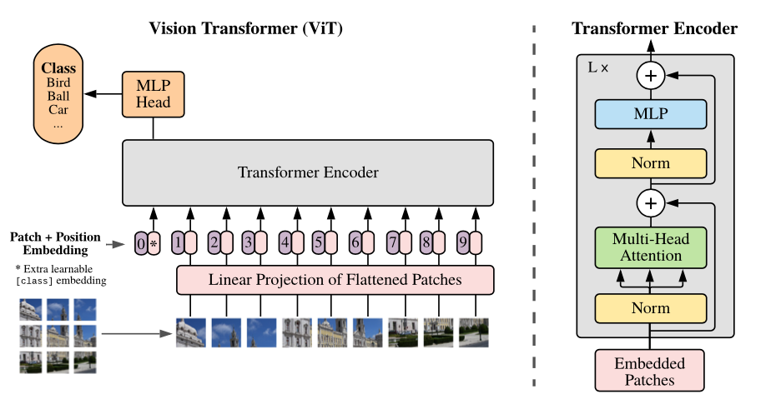
1.2.1 Related Works: Transformer - QKV Self-Attention
Attention?? 量化
= as softmax()
Transformer - QKV Self-Attention
Non-Local NN
=V
3. Global Framework:
Transformer: an encoder-decoder structure.
Transformer using (1) stacked self-attention and point-wise,
(2) fully connected layers for both the encoder and decoder.
Employ residual connections around each of the sub-layers, followed by layer normalization
The encoder composed of stack of N=6 identical layers: each layer has two sub-layers.
1) a multi-head self-attention mechanism.
2) a simple, position-wise fully connected feed-forward network.
The decoder composed of stack of N=6 identical layers: each layer third sub-layer.
1) Masked multi-head attention - Self-attention sub-layer: prevent positions from attending to subsequent positions.
2) performs multi-head attention over the output of the encoder stack.
3) a simple, position-wise fully connected feed-forward network.
Normalize the attention weight to 0~1
Softmax()=weights of V
y_{i}
α₁,_{i i=1, 2,…I}
$$\hat{α\text{1}\text{,}\text{i}}$$
position
scaling factor
pixel-wise self-attention similarity weight
Y=(y₁, ..., y_{m})
(1x1 convolution)
Normalize the attention weight to 0~1
outputs of dimension d_{model} = 512.
Z= (z₁, ..., z_{n=512}).
Softmax()=weights of V
feed-forward network with a single hidden layer. Cross channel process
➔ ?? (1x1x#ch)x#filters + ReLU +
(1x1x#ch)x#filters
N = 6 x identical layers
position
y_{i}
α₁,_{i i=1, 2,…I}
Layer Norm
$$\hat{α\text{1}\text{,}\text{i}}$$
pixel-wise self-attention similarity weight
scaling factor
Self-
K
Q
2) position-wise fully connected feed-forward network
V
=QKV Self-Attention
position
Decoder
y_{i}
z
residual connections
Encoder
Layer Norm
Regularization by using dropout the residual connection
residual connection
Mask: Related to Q
Normalize the attention weight to 0~1
pixel-wise self-attention similarity weight
y➔W*y
f(x_{i},x_{j})=
Self-
Self-
1) multi-head self-attention (MSA) mechanism.
Q
K
V
Q
K
V
Mask: Only for decoder
J: Limit its attention region, like center pixel with Gaussian distribution mask
position
x
position
Transformer Encoder/Decoder:
這兩個的設計概念是一樣的
divide each by $\sqrt{\text{d}\text{k} }$
Reduce dim
Consider geometric
position/distance information.
= same para =
dot products
Q: position
Previous decoder output layer
Input:
X= (x₁, ..., x_{n=512})
dimension d_{k}
d_{v}
Query Q
Key K
Value V

Slide 16
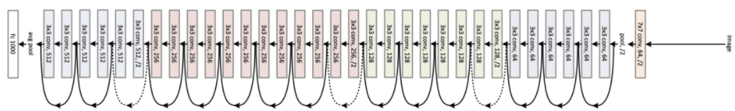
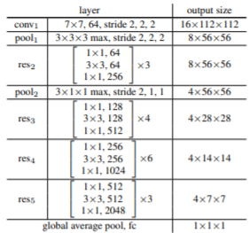
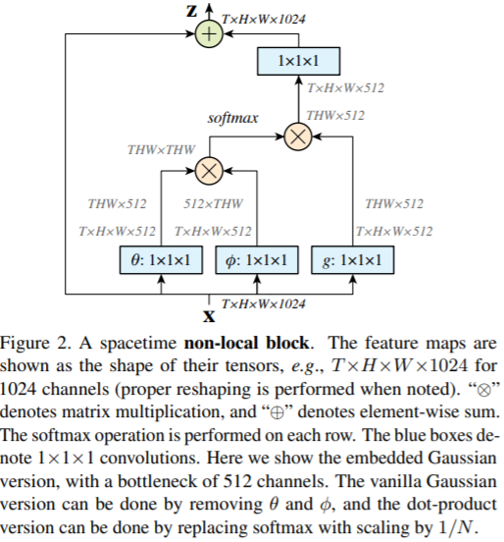
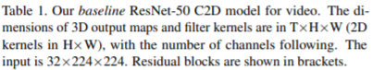
1.2.1 Related Works: Transformer - QKV Self-Attention
Non-Local NN ?? (1/2)
= as softmax()
Non-Local NN
=V
Non-local Neural Network, CVPR2018
Normalize the attention weight to 0~1
Softmax()=weights of V
y_{i}
α₁,_{i i=1, 2,…I}
$$\hat{α\text{1}\text{,}\text{i}}$$
non-local block
position
pixel-wise self-attention similarity weight
scaling factor
Input video: 224x224x32
res2: 112x112
res3: 56x56
res4: 28x28
res5: 14x14
I/P: 32x224x224
Non-local block +identity function
T = # frames input??
TxHxWx512??
W_{z} y_{i}
f(x_{i},x_{j})=
y_{i}
y_{i}
as
pixel-wise self-attention similarity weight
f(x_{i},x_{j})=
$$\hat{α\text{1}\text{,}\text{i}}$$
Residual connection
α₁,_{i i=1, 2,…I}
Q: position
φ(x_{j} ) = W_{φ}x_{j}
g(x_{j} ) = W_{g}x_{j}
θ(x_{i}) = W_{θ}x_{i}
Q: position
Key K
Value V
Query Q
Non-local block + identity function

Slide 17
1.2.1 Related Works: Transformer - QKV Self-Attention
Non-Local NN ?? (1/2)
= as softmax()
Non-Local NN
=V
Non-local Neural Network, CVPR2018
Normalize the attention weight to 0~1
Softmax()=weights of V
y_{i}
α₁,_{i i=1, 2,…I}
$$\hat{α\text{1}\text{,}\text{i}}$$
position
pixel-wise self-attention similarity weight
scaling factor
Layer Norm
Normalize the attention weight to 0~1
Non-local block +identity function
Softmax()=weights of V
position
y_{i}
T = # frames input??
pixel-wise self-attention similarity weight
y_{i}
TxHxWx512??
scaling factor
W_{z} y_{i}
=QKV Self-Attention
f(x_{i},x_{j})=
y_{i}
y_{i}
Normalize the attention weight to 0~1
pixel-wise self-attention similarity weight
as
pixel-wise self-attention similarity weight
f(x_{i},x_{j})=
$$\hat{α\text{1}\text{,}\text{i}}$$
Self-
f(x_{i},x_{j})=
$$\hat{α\text{1}\text{,}\text{i}}$$
Residual connection
Mask: Only for decoder
J: Limit its attention region, like center pixel with Gaussian distribution mask
MSA
α₁,_{i i=1, 2,…I}
α₁,_{i i=1, 2,…I}
divide each by $\sqrt{\text{d}\text{k} }$
dot products
Q: position
φ(x_{j} ) = W_{φ}x_{j}
g(x_{j} ) = W_{g}x_{j}
θ(x_{i}) = W_{θ}x_{i}
Key K
Value V
Query Q
Input:
Q: position
dimension d_{k}
d_{v}
x_{i}
Non-local block + identity function
Query Q
Key K
Value V

Slide 18
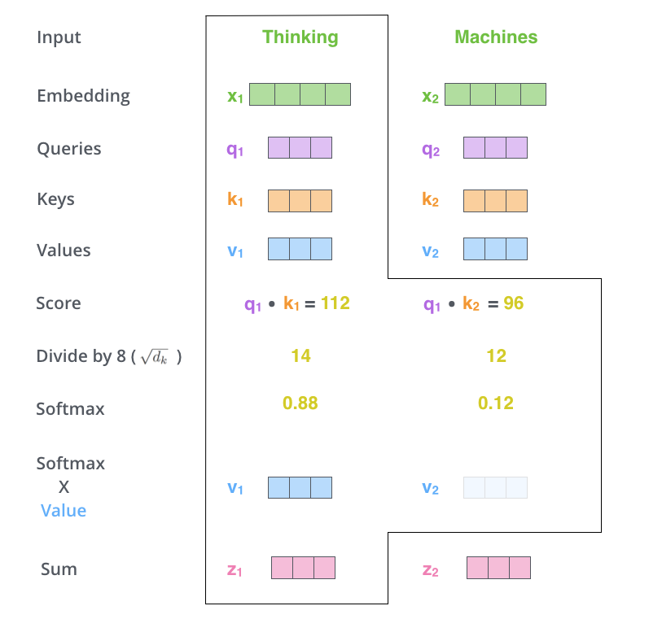
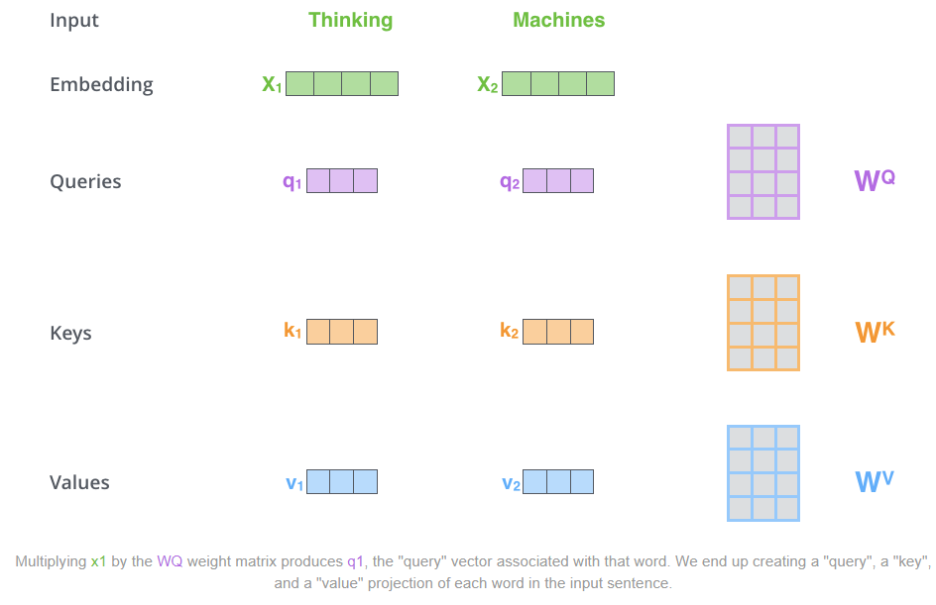
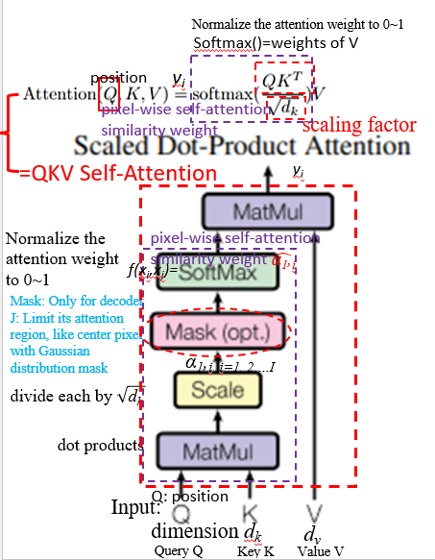

1.2.1 Attention Mechanism: Single Attention
y_{i}
$Attention\left(Q,K,V\right)=softmax\left(\frac{QK^{T}}{\sqrt{d_{k}}}\right)V$ , $\sqrt{d_{k}}$ 用於限縮結果範圍，避免過大
y_{i}
y₁
y₂
y_{i}
Notes:
The self-attention layer calculates attention weights for each pixel in the image based on its relationship with all other pixels, while the feed-forward layer applies a non-linear transformation to the output of the self-attention layer
Read more at: https://viso.ai/deep-learning/vision-transformer-vit/
https://www.v7labs.com/blog/vision-transformer-guide

Slide 19


1.2.1 Attention Mechanism: Single Attention

Slide 20


1.2.1 Attention Mechanism: ?? Single Attention (2/2-1/2)
F: -Why? Create the K, Q, V for each word or pixel by linear transformation (1x1 convolution).
Because the same word has a different meaning in the different combinations.
Self-Attention Layer:
Key
Three elements <Q, K, V>: represents attention mechanism.
The similarity between Query Q and Key K, and assigns the value of Value V according to the similarity.
Definition of Attention formula:
Ex: a sentence consists of 4 Words: It is my dog.
Q: current word or pixel
K: the other 3 words or neighbor pixels
d_{k} : the dimension of q and k
Query
Value
Q: position
y_{i}
α₁,_{i i=1, 2,…I}
$$\hat{α\text{1}\text{,}\text{i}}$$
where V= word in the sentence or the pixel at the image
Pixel-wise self-attention similarity weight
: the dimensions of q and k
Pixel-wise self-attention similarity weight of pixel value V:
$\hat{α\text{1}\text{,}\text{i}}$ = softmax(): similarity between template Query Q and search patch Key K, as weight of V. Important V has the higher weight.
Pixel-wise self-attention similarity weight
4. (q,k) ➔ α_{1,i} ➔ $\hat{α\text{1}\text{,}\text{i}}$ : Output the attention Weight $\hat{α\text{1}\text{,}\text{i}}$ = softmax()
- Soft-max: Normalizing the α₁,_{i ,} 0 < α₁,_{i} <1
3. (q,k) ➔ α_{1,i} : Calculate the similarity of q, k: each query q pays attention to each key k.
- Scale Dot-Product: S(q¹, k¹) = α_{1,1,} S(q¹, k²) = α_{1,2}
₋ α_{1,i} = q₁・k_{i} / $\sqrt{d}$, i=1~I
2. a➔(q,k,v): Each a^{i} input is multiplied by a different vector: q, k, v
q: query (self as template,
為了去匹配其他人)
- q^{i}=W_{q} a^{i}
(2) k: key (as patch within search region
為了被匹配)
⁻ k^{i}=W_{k} a^{i}
(3) V: value (被抽取出來的資訊)
- v^{i}=W_{v} a^{i}
Weight (W_{q}/ W_{k}/ W_{v}) is trained and initialized randomly.
Q: position
Q: position
θ(x_{i}) = W_{θ}x_{i}
φ(x_{j} ) = W_{φ}x_{j}
g(x_{j} ) = W_{g}x_{j}
J: 1x1 spatial conv
as weight w_{q1}, w_{k1}, w_{v1}
1x1 spatial conv
as weight w_{q2}, w_{k2}, w_{v2}
1. x➔a: The input sequence multiplied by a ?? weight matrix to become: a¹,a²,a³,…,a⁴
J: 1x1 spatial conv as weight w
input: x¹, x²,.., x⁴
Word of sentence or
Pixel of image:

Slide 21






1.2.1 Attention Mechanism: Single Attention (2/2-2/2) ??
F: Enhance information form all elements by Q K correlation matrix as similarity weight to V
Correlation: enhance the similar elements
Self-Attention Layer:
y_{i} =
5. The final output size is same as the input sequence.
b¹: the first vector (word or character) of the requested sequence.
y_{i} =
b as Natural Language
- Multiply the obtained attention weight $\hat{α\text{1}\text{,}\text{i}}$ and v to obtain b¹, which is a weighted sum.
Self-attention parallel processing
1x1 conv
?? W(512x512) diagonal matrix
a = W x
1x1 conv
y_{i} =
Q: position
θ(x_{i}) = W_{θ}x_{i}
φ(x_{j} ) = W_{φ}x_{j}
$$\hat{α\text{1}\text{,}\text{i}}$$
α₁,_{i i=1, 2,…I}
g(x_{j} ) = W_{g}x_{j}
as NL
?? 好像寫反了 1,1; 1,2; …
Pixel-wise self-attention similarity weight
y_{i} =
Q: position
as NL
Converted to matrix multiplication: can use GPU to accelerate the calculation.
Pixel-wise self-attention similarity weight’
?? 好像寫反了
1,1; 1,2; …

Slide 22








1.2.2 Related Works:
Attention Mechanism: Multi-Head Self-Attention (MSA)
MSA: 一組QKV可以想像成對應一種特徵，利用更多的QKV來表示多種特徵，類似在conv中，多個filter來萃取不同影像特徵的概念。
Multi-head self-attention layer: key words of sentence
Found it beneficial to linearly project the Q, K and V h times with different, learned linear projections to d_{q}, d_{k} and d_{v} dimensions.
Single attention function with d_{model}-dimensional K, V and Q.
Each head focuses on different information, some only care about local information, some only care about global information.
ex: 2-head self-attention:
1) Split q, k, v into two q, k, v: q_{i,1} only be multiplied by k_{i,1} to get α_{i,1} finally b_{i,1.}
2) Concate b_{i,1} , b_{i,2} together, multiply it by a transform, and do dimensionality reduction to get the final b_{i}.
=QKV Self-Attention
=Multi-Head Self-Attention (MSA)
y_{i} =
Multi-head attention: h=8
$$\hat{α\text{1}\text{,}\text{i}}$$
??
α₁,_{i i=1, 2,…I}
Q: position
Q: position
Q: position
Attention Visualization
Single-head
Multi-head
??
local
??
global
The relationship between the two words, the thicker line means the deeper the connection.
Different sets of q and k have different results and have different information.

Slide 23




1.2.2 Related Works:
Attention Mechanism: Multi-Head Self-Attention (MSA)
$b^{i}$
MSA (Multi-Head Self-Attention Layer)
Linear Convolution
Attention head = 2
concatenate
$$b^{i,1},b^{i,2}$$
$$α_{ii,1}=q^{i,1}∙Transpose(k^{i,1})$$
Sum
：矩陣乘常數
$b^{i,1}=$ Attention(Q,K,V)
= $Softmax\left(\frac{QK^{T}}{\sqrt{d}}+B\right)V$
：矩陣内積
Sum
Attention head = 2 = as feature maps
$$α_{ii,1}$$
$$α_{ij,1}$$
$$α_{ii,2}$$
$$α_{ij,2}$$
Attention(Q,K,V)
= $Softmax\left(\frac{QK^{T}}{\sqrt{d}}+B\right)V$
Attention head h = 2
Q ➔ All q
K ➔ All k
d ➔ scale factor (make variance from d to 1)
B ➔ learnable relative position (Bias or Bias = 0)
Input: $a^{i}, a^{j}$
W: Linear Convolution （Transform)
2 patches

Slide 24
1.2.3 Related Works [7]
Vision Transformer (ViT) [7]
Transformer Layer Module (TLM)
TLM block
4. Image Classification Using MLP Head (FC Layer)
1) Only Class Vector is taken to do this.
J: Spatial:
Fully connected network for further extraction as pixel-wise convolution.
Class Vector
Dimension Transfer
3.Feature Extraction in Transformer Encoder
Layer Norm
Position of patch: (0,0), (1,0), …(2,2)
Patch
MSA:
Class Vector
Self-
Feature extraction
Reshape 2D to 1D
Layer Norm
H
16 pixels
2. Preprocess Patch Images in Embedded Patched
1) Reshape 2D to 1D - Flatten Patch Images, Project 256 vector (16x16) to shorter vector and Embedding Position to each Vector Before Input to Transformer Encoder
2) Class Vector is added only to be taken to MLP/FC Layer for Classification after transformer encoder
$$I_{o}$$
16 pixels
W
1. Separate image to (PxP) patches, P=16
Information about patch geo. position
Problem of ViT:1) The number of patch depend on the size of the image and the patch.
Ex: Image size= 256x256 , Patch size= 16x16 pixels ➔ Patch number = 16
Image size= 1264x1264 , Patch size= 16x16 pixels ➔ Patch number = 79
2) To extract smaller feature of input image, we need smaller size patches. Which mean increase the patch number.
Q: Too many patches will need more calculation time and memory on transformer.
Notes:
There are two main approaches to exploiting global context
information:
the encoder-decoder architecture and
Pyramid pooling.

Slide 25



1.2.3 Related Works: Transformer Encoder
Dimension Transfer
Feature extraction
對於Encoder的第l層，記其輸入為$z_{l−1}，$輸出為$z_{l}。$
$$z_{0}:Encoder first input$$
$X_{p}^{1},….,X_{p}^{N}: 還未$Linear Projection的patch embedding(都是$P^{2}C$ 維)
$X_{p}^{1}E,….,X_{p}^{N}E:經過$E做linear projection ，使每個patch的維度都是D維
$$E_{pose}:postion Embedding$$
$$LN:Layer Normalization$$
Notes:
The self-attention layer calculates attention weights for each pixel in the image based on its relationship with all other pixels, while the feed-forward layer applies a non-linear transformation to the output of the self-attention layer
Read more at: https://viso.ai/deep-learning/vision-transformer-vit/
https://www.v7labs.com/blog/vision-transformer-guide

Slide 26


1.2.3 Related Works: Transformer Encoder – ??
Multi-Layer Perceptron(MLP) Vs. FFN VitPose Cvpr2022
Feedforward Neural Network: (FFN)
資料經由輸入層通過隱藏層(hedden layer)到輸出層單向傳播，神經元(neuron)之間沒有連接迴路存在, Not fully connected layer
Dimension Transfer
Feature extraction
Multi-Layer Perceptron (MLP)
A multilayer perceptron is a special case of a feedforward neural network where every layer is a fully connected layer.
Notes:
The self-attention layer calculates attention weights for each pixel in the image based on its relationship with all other pixels, while the feed-forward layer applies a non-linear transformation to the output of the self-attention layer
Read more at: https://viso.ai/deep-learning/vision-transformer-vit/
https://www.v7labs.com/blog/vision-transformer-guide

Slide 27




1.2.3 Related Works [8] ??
Swin Transformer [8] (Swin Transformer Blocks)
Layer Norm
Reshape 2D to 1D
Layer Norm
Why MLP?? J: Because transformer has no convolution, so it uses MLP instead of convolution
Take many parameters
MLP (Multilayer perceptron)
TLM block
2 Fully Connect Layer
W-MSA
add
add
Input
$NxN$ patches
Output
M windows
SW-MSA
Shifted window
add
add
$\frac{N}{2}$
(1, d)
$\frac{N}{2}$
(1,d)
家銘：類似於做point-wise convolution，再萃取的功能
(1, 4d)
Layer normalize
LN : Layer Normalization
SW-MSA: Window Multiple-Head Self Attention
W-MSA: Shifted Window Multiple-Head Self Attention
Notes:
There are two main approaches to exploiting global context
information:
the encoder-decoder architecture and
Pyramid pooling.

Slide 28







1.2.3 Related Works [8]- Downsampling by Patch Merging
Swin Transformer [8]
後面會加上 FC/MLP 來進行分類
(或可當成 R-CNN的 Backbone)
1. Resize the Image from HxWx3 to $\frac{H}{4}x\frac{W}{4}x 48c$
2. Feature Extract
C=96
Swin Transformer also propose patch merging to downsampling the feature map. (Will discuss in next page)
Linear Embedding: 邦尉：可看成 (1x1x48c)x96filters
家銘：Patch merge 在每個stage之前進行downsampling，相比一般CNN downsampling使用convolution stride>2的方法可以省下計算量，同時又可以保留特徵
Patch Merging:
(1x1x4c)x2filters
Rearrange
$$\frac{H}{4}x\frac{W}{4}x 96$$
$$\frac{H}{4}x\frac{W}{4}x 96$$
$$\frac{H}{8}x\frac{W}{8}x (96x2x2)$$
$$\frac{H}{8}x\frac{W}{8}x (96x2x2)$$
$$\frac{H}{8}x\frac{W}{8}x (96x2)$$
Notes:
There are two main approaches to exploiting global context
information:
the encoder-decoder architecture and
Pyramid pooling.

Slide 29


1.2.3 Related Works [8] ??
參考右圖
$\frac{N}{2}$
Swin Transformer [8] (Masked MSA)
$\frac{N}{2}$
家銘：讓SW-MSA和W-MSA的做self-attention的方法一樣，只要做圖像的位移和mask找到要的結果就可以。
q
q
Transpose(k)
Transpose(k)
7,1
7,1
q
q
5,3
5,3
8,6
8,2
8,0
Transpose(k)
5,3
Transpose(k)
5,3
6,8
6,2
6,0
5,3
5,3
2,8
2,6
2,0
5,3
5,3
0,8
0,6
0,2
Diagonal is self-correlation, others are cross-correlation
White part is masked (will not be read) after multi-head self attention layer
Notes:
There are two main approaches to exploiting global context
information:
the encoder-decoder architecture and
Pyramid pooling.

Slide 30

1.2.3 Related Works [8]
Swin Transformer [8] (Layer Normalization)
Convolution with Multiple Filter m:
Set 1 batch has b dataset (b maps)
Batch Input:
Batch normalization calculate mean and variance of all of the batches output in one filter
Layer normalization calculate mean $μ$ and variance $σ$ of all of the filters output in one batch
Output (mean $μ$, variance $σ$)
Figure below visualize different types of normalization.
Instance Norm:
Only normalize each output image independently
Group Norm:
Only normalize pre-set amount (one group) of output image independently
H: Height
W: Width
C: Channel
N: Batch size
1D HxW
Note: H,W is a 1D vector which flatten from 2D image
Notes:
There are two main approaches to exploiting global context
information:
the encoder-decoder architecture and
Pyramid pooling.

Slide 31

1.2.4 Related Works: Neighborhood Attention Transformer (NAT) arXiv2022 Introduction: Motivation & Objective
Motivation:
Higher image resolution results in a quadratic increase in complexity and memory usage in models strictly using self-attention, such as ViT.
Convolutions benefit from inductive biases such as locality, translational equivariance, and 2-dimensional neighborhood structure, while dot-product self attention is a global 1-dimensional operation by definition.
Local attention modules were therefore applied to alleviate this issue. Swin was one of the first hierarchical vision transformers based on local self attention.
Performing self attention using fix location attention windows and only shift windows once after passing through. Cause the receptive field imbalance.
Objective:
The sliding-window pattern allows NA’s receptive field to grow without needing extra pixel shifts, and preserves translational equivariance, unlike Swin Transformer’s Window Self Attention (WSA).
銘：這篇主要是想跟Swin-Transformer來比較
Figure 2. Illustration of the query-key-value structure of Neighborhood Attention (NA) vs Self Attention (SA) for a single pixel. SA allows each pixel to attend to every other pixel, whereas NA localizes attention for each pixel to a neighborhood around itself. Therefore, each pixel’s attention span is usually different from the next.

Slide 32


1.2.4 Related Works: Neighborhood Attention Transformer (NAT) arXiv2022 Introduction: Global Framework
0. Input
1. Encoder
3. Head using FC Layer
224 x 224
56 x 56
28 x 28
14 x 14
7 x 7
(1x1xP)
x1000
$$N_{1}=3$$
$$N_{1}=4$$
$$N_{1}=18$$
$$N_{1}=5$$
NAT embeds inputs using (3×3×C) × 2 convolutions with 2 × 2 strides, resulting in a spatial size 1/4th the size of the input.
銘： instead of 2 × 2 non-overlapping convolutions that Swin uses (patch merge).
銘：類似於convolution的概念，只和周圍的區塊算attetion
Figure 5. An overview of our model, NAT, with its hierarchical design. The model starts off with a convolutional downsampler, then moves on to 4 sequential levels, each consisting of multiple NAT Blocks, which are transformer-like encoder layers. Each layer is comprised of a multi-headed neighborhood attention (NA), a multi-layered perceptron (MLP), Layer Norm (LN) before each module, and skip connections. Between the levels, feature maps are downsampled to half their spatial size, while their depth is doubled. This allows for easier transfer to downstream tasks through feature pyramids.

Slide 33

1.2.4 Related Works: Neighborhood Attention Transformer (NAT) arXiv2022
Figure 1. An illustration of attention spans in Self Attention, Shifted Window Self Attention, and our Neighborhood Attention. Self Attention allows each token to attend to everything. Window Self Attention divides self attention into non-overlapping sub-windows, and is followed by Shifted Window Self Attention, which allows for out-of-window interactions that are necessary to receptive field expansion. Neighborhood Attention localizes attention to a neighborhood around each token, introducing local inductive biases, maintaining translational equivariance, and allowing receptive field growth without needing extra operations

Slide 34
1.2.4 Related Works: Neighborhood Attention Transformer (NAT) arXiv2022
W-MSA
$NxN$ patches
SW-MSA
Shifted window
$\frac{N}{2}$
$\frac{N}{2}$
因爲每個pixel 都會shift window,
不需要多一個SW-MSA
Window size

Slide 35



1.2.4 Multi-Head Self-Attention (MSA) Vs. CNN Iclr2020
Self-Attention: 如果我們今天用 self-attention 來處理一張圖片一個 pixel 產生 query，其他的 pixel 產生 key。在進行 inner product 時候不是考慮一個小的區域而是整張的資訊。
而CNN: 因convolution，所以會畫出一個 receptive field 每一個 filter 只考慮 receptive field 範圍裡面的資訊
q: query (self as template,
為了去匹配其他人)
- q^{i}=W_{q} a^{i}
(2) k: key (as patch within search region
為了被匹配)
⁻ k^{i}=W_{k} a^{i}
(3) V: value (被抽取出來的資訊)
- v^{i}=W_{v} a^{i}
Weight (W_{q}/ W_{k}/ W_{v}) is trained and initialized randomly.
Q: position
Q: position
Notes:
https://andy6804tw.github.io/2021/05/03/ntu-multi-head-self-attention/#self-attention-%E8%88%87-cnn-%E6%AF%94%E8%BC%83

Slide 36
1.3 Contribution
We present the first study to investigate the usage of Transformers for general medical image segmentation.
TransUNet employs a hybrid CNN-Transformer architecture to leverage both detailed high-resolution spatial information from CNN features and the global context encoded by Transformers.

Slide 37
2.1 System Setup

Slide 38
2.2 Function Specification (功能 & 規格)

Slide 39








3.1.1 Training Framework
0. Data augmentation
1. DownSampling
3. UpSampling
$$H×W×1C$$
Hybrid Model ??
1. ResNet50改良(Reference: ViT[4])
2. BatchNorm改成GroupNorm
3. 傳統的Conv2d改成StdConv2d
Flip
Why Hybrid Model ??
主要因為BN受batch size大小的影響大(需大量Resource)，BN中權重的更新對於Transfer Learning不友好
Reference: (1912.11370.pdf (arxiv.org))
Rotation
(8, H, W)
$$\frac{H}{2}×\frac{W}{2}×64c$$
L = $\frac{1}{2}$ $L_{ce}$ + $\frac{1}{2}$ $L_{dice}$
$$\frac{H}{4}×\frac{W}{4}×256c$$
$$\frac{H}{8}×\frac{W}{8}×512c$$
$$\frac{H}{16}×\frac{W}{16}×1024c$$
GT
$$\frac{H}{16}×\frac{W}{16}×1024c$$
2. Transformer
1). patch vector
3). Multi Head Self-Attention (x12)
${x_{p}=\{x}_{p}^{i}$ Є $R^{1×(p^{2}×1024c)} \left| i=1,…N\right\}, N=\frac{HW}{{16}^{2}p^{2}}, p=1$
$$z_{i}^{′} =LN\left(MSA\left(z_{i}\right)\right)+z_{i}$$
$$p:patch size, N:number of patch$$
$J$ack ??
$$z_{i+1}=LN\left(MLP\left(z_{i}^{′}\right)\right)+z_{i}^{′}$$
$, i=0 \sim 11$
$$z_{12}\text{Є} R^{N×D}$$
2). patch embedding & position embedding
$$z_{0}=$$
$$z_{i}$$
$$z_{i+1}$$
$$(token)$$
$E$ Є $R^{\left(p^{2}×1024c\right)×D}, { E}_{pos}$Є $R^{1×D},z_{0}\text{Є} R^{N×D}$

Slide 40



3.1.2 Loss function
Total loss L = $\frac{1}{2}$ $L_{ce}$ + $\frac{1}{2}$ $L_{dice}$ ($L_{ce}$: cross entropy loss, $L_{dice}$: dice loss)
$L_{ce}$: cross entropy loss
$$L_{ce}=\sum_{c=1}^{C}{\sum_{i=1}^{n}{−y_{c,i}\log{p_{c,i}}}}$$
$L_{dice}$: dice loss
$$L_{dice}=\frac{1}{C}(1−\sum_{c=1}^{C}{\frac{2\sum_{i=1}^{n}{{(y}_{c,i}}p_{c,i})}{\sum_{i=1}^{n}{y_{c,i}^{2}}+\sum_{i=1}^{n}{p_{c,i}^{2}}})}$$
Jack: 每個class計算出dice loss再取平均
$y_{c,i}$: groundTruth label
$p_{c,i}$: predict confidence
c: c-th class (C: number of classes)
i: i-th pixel (N: number of pixels)

Slide 41






3.1.3 Inference Framework
1. DownSampling
3. UpSampling
$$H×W×1C$$
Hybrid Model ??
1. ResNet50改良(Reference: ViT[4])
2. BatchNorm改成GroupNorm
3. 傳統的Conv2d改成StdConv2d
$$\frac{H}{2}×\frac{W}{2}×64c$$
Why Hybrid Model ??
主要因為BN受batch size大小的影響大(需大量Resource)，BN中權重的更新對於Transfer Learning不友好
Reference: (1912.11370.pdf (arxiv.org))
$$\frac{H}{4}×\frac{W}{4}×256c$$
$$\frac{H}{8}×\frac{W}{8}×512c$$
(8, H, W)
$$\frac{H}{16}×\frac{W}{16}×1024c$$
$$\frac{H}{16}×\frac{W}{16}×1024c$$
2. Transformer
1). patch vector
3). Multi Head Self-Attention (x12)
${x_{p}=\{x}_{p}^{i}$ Є $R^{1×(p^{2}×1024c)} \left| i=1,…N\right\}, N=\frac{HW}{{16}^{2}p^{2}}, p=1$
$$z_{i}^{′} =LN\left(MSA\left(z_{i}\right)\right)+z_{i}$$
$$p:patch size, N:number of patch$$
$J$ack ??
$$z_{i+1}=LN\left(MLP\left(z_{i}^{′}\right)\right)+z_{i}^{′}$$
$, i=0 \sim 11$
$$z_{12}\text{Є} R^{N×D}$$
2). patch embedding & position embedding
$$z_{0}=$$
$$z_{i}$$
$$z_{i+1}$$
$$(token)$$
$E$ Є $R^{\left(p^{2}×1024c\right)×D}, { E}_{pos}$Є $R^{1×D},z_{0}\text{Є} R^{N×D}$

Slide 42


4.1 Data Collection and Metric
1) Data Collection
(1) ACDC dataset
ACDC challenge collects exams from different patients acquired from MRI scanners. Cine MR images were acquired in breath hold, and a series of short-axis slices cover the heart from the base to the apex of the left ventricle
a) patients: 100 sample
b) resolution: thickness of 5 to 8 mm, 0.83 to 1.75$mm^{2}$/pixel
c) classes: left ventricle(LV), right ventricle (RV) and myocardium (MYO)
(左心室、右心室、心肌)
(2) Synapse dataset
Synapse multi-organ segmentation dataset1 . We use the 30 abdominal CT scans in the MICCAI 2015 Multi-Atlas Abdomen Labeling Challenge, with 3779 axial contrast-enhanced abdominal clinical CT images in total.
a) patients: 30 sample
b) resolution: ([0.54 ∼ 0.54] × [0.98 ∼ 0.98] × [2.5 ∼ 5.0]) $mm^{3}$
c) classes: aorta, gallbladder, left kidney, right kidney, liver, pancreas, spleen, stomach
(主動脈、膽囊、左腎、右腎、肝臟、胰腺、脾臟、胃)

Slide 43











4.1 Data Collection and Metric
2) Metric
Hausdorff distance
$$P$$
$$G$$
$$H\left(P, G\right)=max⁡\{h\left(P, G\right), h(G, P)\}$$
$$h\left(P, G\right)=\max_{pєP}{\{\min_{gєG}\left\|p−g\right\|\}}$$
$$h\left(P, G\right)$$
$$h\left(G, P\right)=\max_{gєG}{\{\min_{pєP}\left\|p−g\right\|\}}$$
$$h\left(G, P\right)$$
$\left\|p−g\right\|$: a與b之間得歐式距離
Jack: 藉由contour之間的距離來判斷segm的好壞
Dice similarity coefficients (DSC)
$$=\frac{2×(AՈB)}{AՍB}$$

Slide 44

4.2 Experimental Results
Compare different number of shortcut (Synapse dataset)
1) Show DSC at different number of shortcut
2) 3-skip model have better performance than other

Slide 45



4.2 Experimental Results
Compare different input resolution and patch size (Synapse dataset)
1) large input resolution, get better DSC (Table2)
2) small patch size (transformer), get better DSC (Table3) reason??
3) Smaller hidden size D-dim、 number of layers、MLP size is “base model”, otherwise is “large model”, and “large model” get better DSC (Table4) (more parameter)

Slide 46


4.2 Experimental Results
Compare different model DSC & HD

Slide 47

4.2 Experimental Results
Compare different model result image

Slide 48
5. Conclusion
TransUNet achieves superior performances than various competing methods, including CNN-based self-attention methods.
TransUNet was proposed, which not only encodes strong global context by treating the image features as sequences but also well utilizes the low-level CNN features via a u-shaped hybrid architectural design.

Slide 49
R. Reference
Child, R., Gray, S., Radford, A., Sutskever, I.: Generating long sequences with sparse transformers. arXiv preprint arXiv:1904.10509 (2019)
Deng, J., Dong, W., Socher, R., Li, L.J., Li, K., Fei-Fei, L.: Imagenet: A largescale hierarchical image database. In: 2009 IEEE conference on computer vision and pattern recognition. pp. 248–255. Ieee (2009)
Devlin, J., Chang, M.W., Lee, K., Toutanova, K.: Bert: Pre-training of deep bidirectional transformers for language understanding. arXiv preprint arXiv:1810.04805 (2018)
Dosovitskiy, A., Beyer, L., Kolesnikov, A., Weissenborn, D., Zhai, X., Unterthiner, T., Dehghani, M., Minderer, M., Heigold, G., Gelly, S., et al.: An image is worth 16x16 words: Transformers for image recognition at scale. In: ICLR (2021)
Fu, S., Lu, Y., Wang, Y., Zhou, Y., Shen, W., Fishman, E., Yuille, A.: Domain adaptive relational reasoning for 3d multi-organ segmentation. In: International Conference on Medical Image Computing and Computer-Assisted Intervention. pp. 656–666. Springer (2020)
He, K., Zhang, X., Ren, S., Sun, J.: Deep residual learning for image recognition. In: Proceedings of the IEEE conference on computer vision and pattern recognition. pp. 770–778 (2016)
Li, X., Chen, H., Qi, X., Dou, Q., Fu, C.W., Heng, P.A.: H-denseunet: hybrid densely connected unet for liver and tumor segmentation from ct volumes. IEEE transactions on medical imaging 37(12), 2663–2674 (2018)
Long, J., Shelhamer, E., Darrell, T.: Fully convolutional networks for semantic segmentation. In: Proceedings of the IEEE conference on computer vision and pattern recognition. pp. 3431–3440 (2015)
Milletari, F., Navab, N., Ahmadi, S.A.: V-net: Fully convolutional neural networks for volumetric medical image segmentation. In: 3DV (2016)
Oktay, O., Schlemper, J., Folgoc, L.L., Lee, M., Heinrich, M., Misawa, K., Mori, K., McDonagh, S., Hammerla, N.Y., Kainz, B., et al.: Attention u-net: Learning where to look for the pancreas. MIDL (2018)
Parmar, N., Vaswani, A., Uszkoreit, J., Kaiser, L., Shazeer, N., Ku, A., Tran, D.: Image transformer. In: International Conference on Machine Learning. pp. 4055– 4064. PMLR (2018)

Slide 50
R. Reference
Ronneberger, O., Fischer, P., Brox, T.: U-net: Convolutional networks for biomedical image segmentation. In: International Conference on Medical image computing and computer-assisted intervention. pp. 234–241. Springer (2015)
Schlemper, J., Oktay, O., Schaap, M., Heinrich, M., Kainz, B., Glocker, B., Rueckert, D.: Attention gated networks: Learning to leverage salient regions in medical images. Medical image analysis 53, 197–207 (2019)
Vaswani, A., Shazeer, N., Parmar, N., Uszkoreit, J., Jones, L., Gomez, A.N., Kaiser, L., Polosukhin, I.: Attention is all you need. In: Advances in neural information processing systems. pp. 5998–6008 (2017)
Wang, X., Girshick, R., Gupta, A., He, K.: Non-local neural networks. In: Proceedings of the IEEE conference on computer vision and pattern recognition. pp. 7794–7803 (2018)
Yu, L., Cheng, J.Z., Dou, Q., Yang, X., Chen, H., Qin, J., Heng, P.A.: Automatic 3d cardiovascular mr segmentation with densely-connected volumetric convnets. In: International Conference on Medical Image Computing and Computer-Assisted Intervention. pp. 287–295. Springer (2017)
Yu, Q., Xie, L., Wang, Y., Zhou, Y., Fishman, E.K., Yuille, A.L.: Recurrent saliency transformation network: Incorporating multi-stage visual cues for small organ segmentation. In: Proceedings of the IEEE conference on computer vision and pattern recognition. pp. 8280–8289 (2018)
Zheng, S., Lu, J., Zhao, H., Zhu, X., Luo, Z., Wang, Y., Fu, Y., Feng, J., Xiang, T., Torr, P.H., et al.: Rethinking semantic segmentation from a sequence-to-sequence perspective with transformers. arXiv preprint arXiv:2012.15840 (2020)
Zhou, Y., Xie, L., Shen, W., Wang, Y., Fishman, E.K., Yuille, A.L.: A fixedpoint model for pancreas segmentation in abdominal ct scans. In: International conference on medical image computing and computer-assisted intervention. pp. 693–701. Springer (2017)
Zhou, Z., Siddiquee, M.M.R., Tajbakhsh, N., Liang, J.: Unet++: A nested u-net architecture for medical image segmentation. In: Deep Learning in Medical Image Analysis and Multimodal Learning for Clinical Decision Support, pp. 3–11. Springer (2018

